Slide 1


Test Case Generation Based on Use Cases
Presentation | Group
Date: May 22, 2025

Slide 2
Group Members
Hafiz Muhammad Shayan Ali
Abdul Nafeh
Abdul Haseeb
Danish Habib
Saad Bashir

Slide 3

Introduction to Test Cases
Definition:
A test case is a set of conditions or actions designed to verify whether a software application behaves as expected.

Slide 4
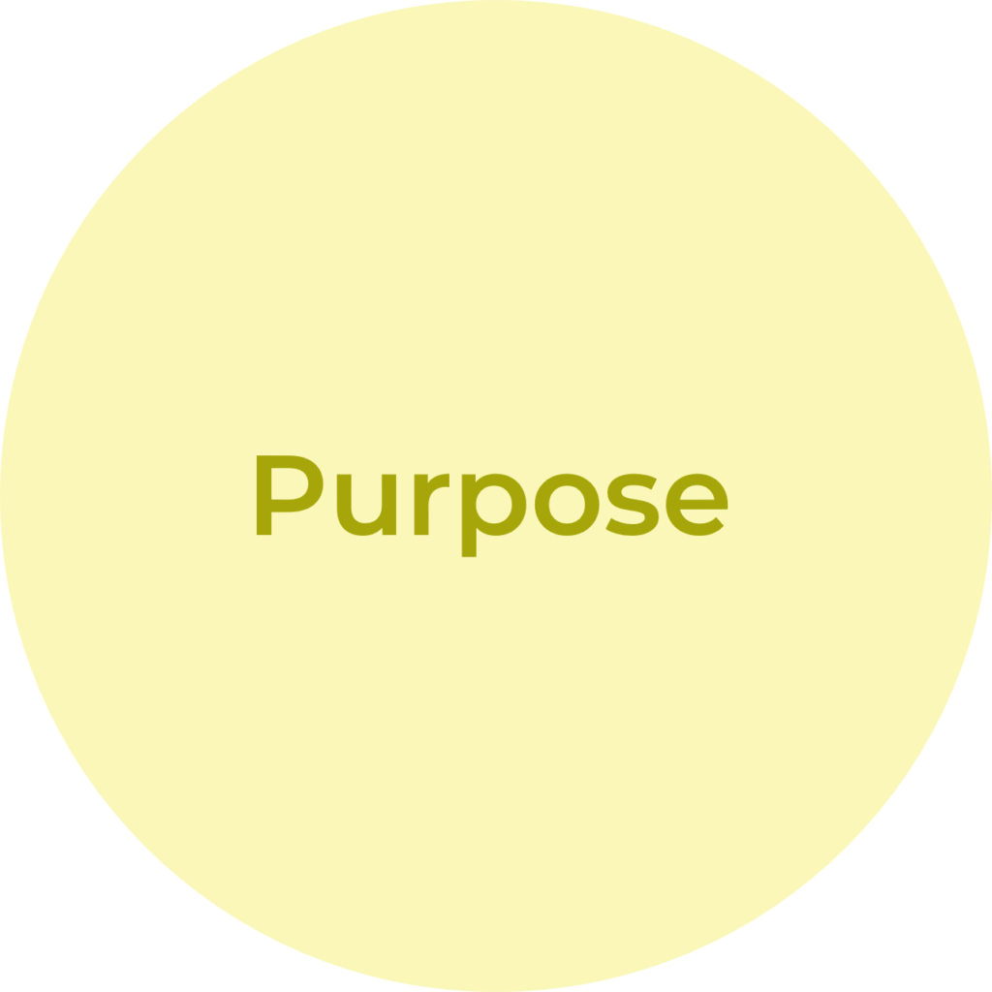
Introduction to Test Cases
Purpose:
Ensure software meets user requirements.
Identify defects early in development.
Provide clear documentation for testing.
Validate functionality aligns with user needs.

Slide 5
Introduction to Test Cases
Components
Test Case ID
Description
Input Data
Expected Result / Output
Actual Result / Output
Status (Pass/Fail)

Slide 6

Format Example

Slide 7
Understanding Use Cases
Definition: A use case describes how a user (actor) interacts with a system to achieve a specific goal.
Key Elements:
Actor (user or system)
Preconditions (initial conditions)
Main Flow (primary steps)
Alternative Flows (exceptional scenarios)
Postconditions (final state)

Slide 8
Use Cases vs Test Case
Use Cases
Describes user goals.
Focuses on system behavior from the user’s view.
Used to define requirements and workflows.
.
Test Cases
Tests specific functionality.
Focuses on validation from the tester’s view.
Used to find defects and ensure quality.

Slide 9
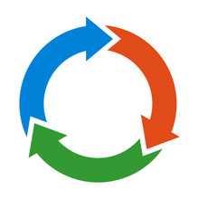
Steps to Derive Test Cases from Use Cases
Analyze the Use Case: Understand the actor, goals, and all flows.
Identify Test Scenarios: Map main and alternative flows to scenarios.
Break Down into Test Cases: Translate each step into testable actions.
Define Inputs and Outputs: Specify inputs and expected results.
Include Positive and Negative Cases:
Positive: Successful scenarios.
Negative: Error or edge cases.

Slide 10


Why Use Use Cases for Test Cases?
Reflects real-world user interactions.
Ensures comprehensive functional coverage.
Links test cases to user requirements for traceability.
Helps identify missing or unclear requirements early.

Slide 11
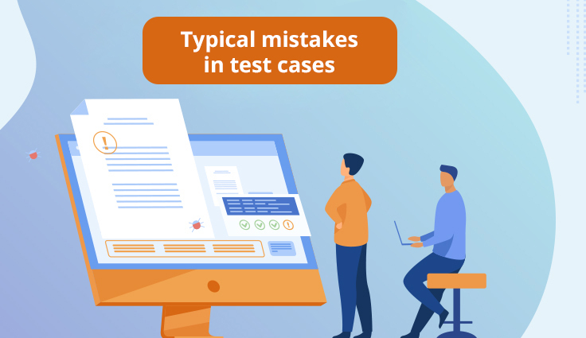
Common Mistakes in Test Case Writing
Skipping negative or edge case testing.
Not updating tests when requirements change.
Using unclear or incomplete test data
Not reusing test cases, creating extra work

Slide 12

Templates and Tools
Templates
Standardize test case format for consistency and completeness.
Tools
Use test management tools like JIRA or TestRail to organize and track test cases.
Benefits
Improved collaboration, tracking, and reporting.

Slide 13

Balancing Manual and Automated Testing
Manual Testing
Best for exploratory, usability, and ad-hoc testing.
Captures real user experiences.
Automated Testing
Ideal for regression, performance, and repetitive tests.
Saves time for large test suites using tools like Selenium.

Slide 14
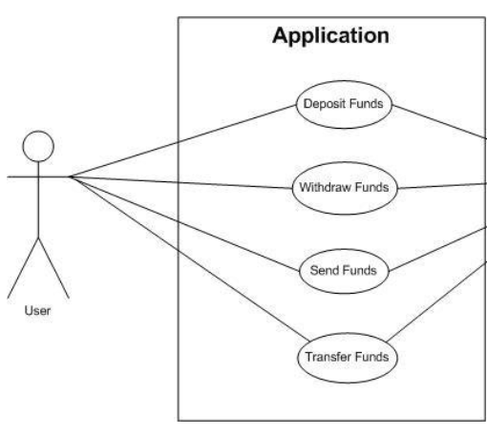
Example 1 - Online Banking: Transfer Money
Use Case:
Actor: Bank Customer
Preconditions: Customer is logged in, has sufficient balance,
recipient account exists.
Main Flow:
Select "Transfer Money.“
Enter recipient account number and amount.
Confirm transfer.
System processes transfer and updates accounts.
Display confirmation.
Alternative Flows:
Insufficient balance.
Invalid recipient account.
Network failure.

Slide 15
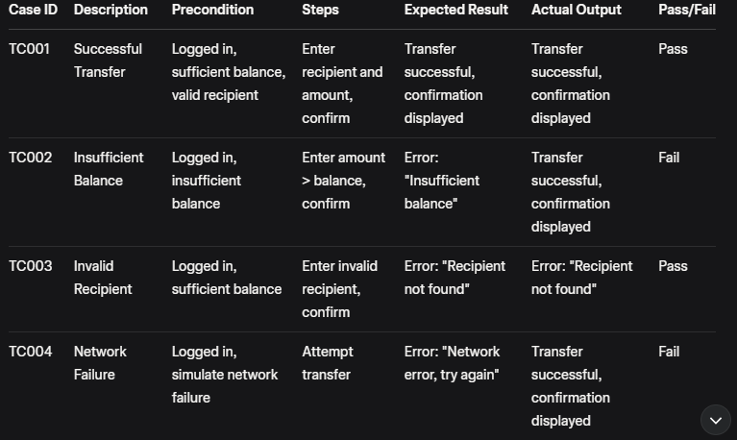
1: Transfer Money Example

Slide 16
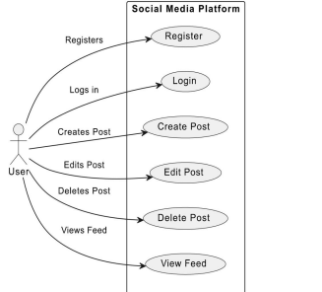
Example 2 - Social Media: Post a Status Update
Use Case:
Actor: Registered User
Preconditions: User is logged in.
Main Flow:
Click "Post Update."
Enter status text.
Click "Post."
Post appears on timeline.
Alternative Flows:
Empty status field.
Status exceeds character limit.
Prohibited content.

Slide 17
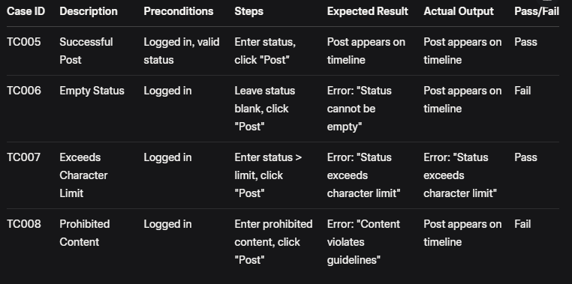
2: Post Status update Example

Slide 18
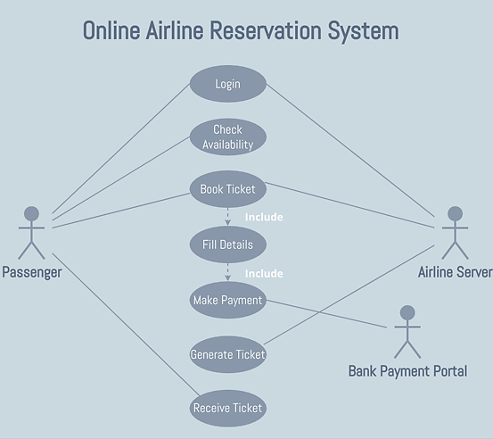
Example 3 - Travel Booking: Search for Flights
Use Case:
Actor: Traveler
Preconditions: User is on flight search page.
Main Flow:
Select departure and arrival cities.
Choose travel dates.
Click "Search Flights."
Display available flights.
Alternative Flows:
Invalid dates.
No flights available.

Slide 19
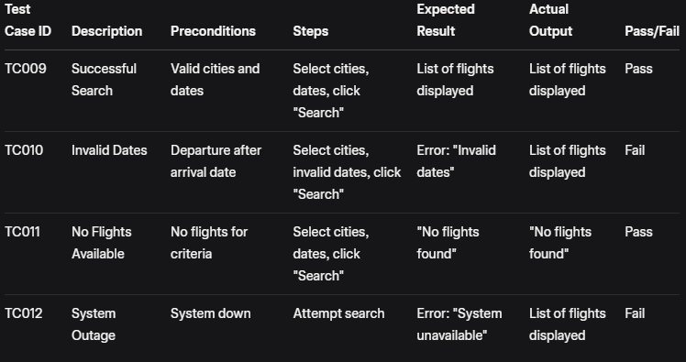
3: Search For Flight Example

Slide 20

Conclusion
Test cases from use cases ensure robust software testing.
Comprehensive testing improves quality and user satisfaction.
Use templates and tools for efficient test management.

Slide 21
THANKYOU

